Slide 1
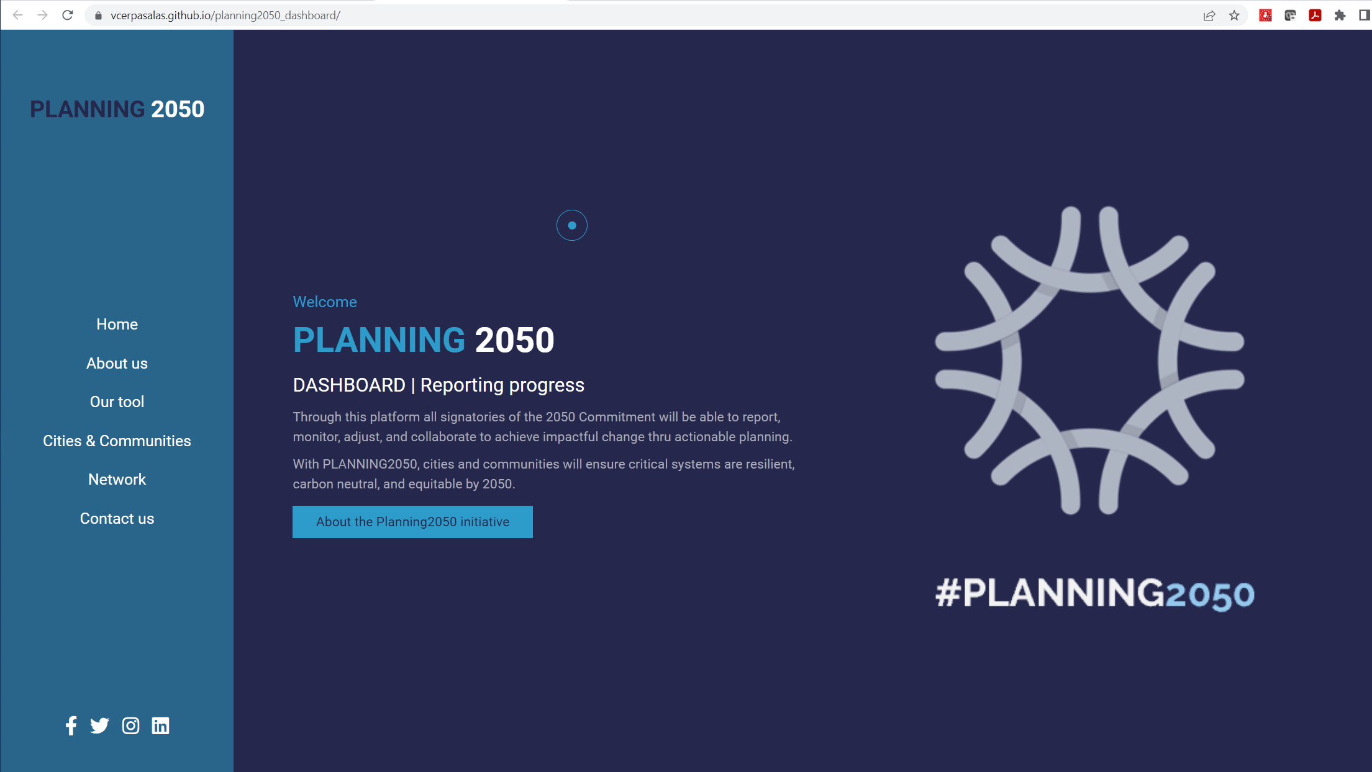
Takes you to:
#tool section of page
Takes you to:
https://planningcommitment.org/
Add button “Login” – takes you to login page

Slide 2
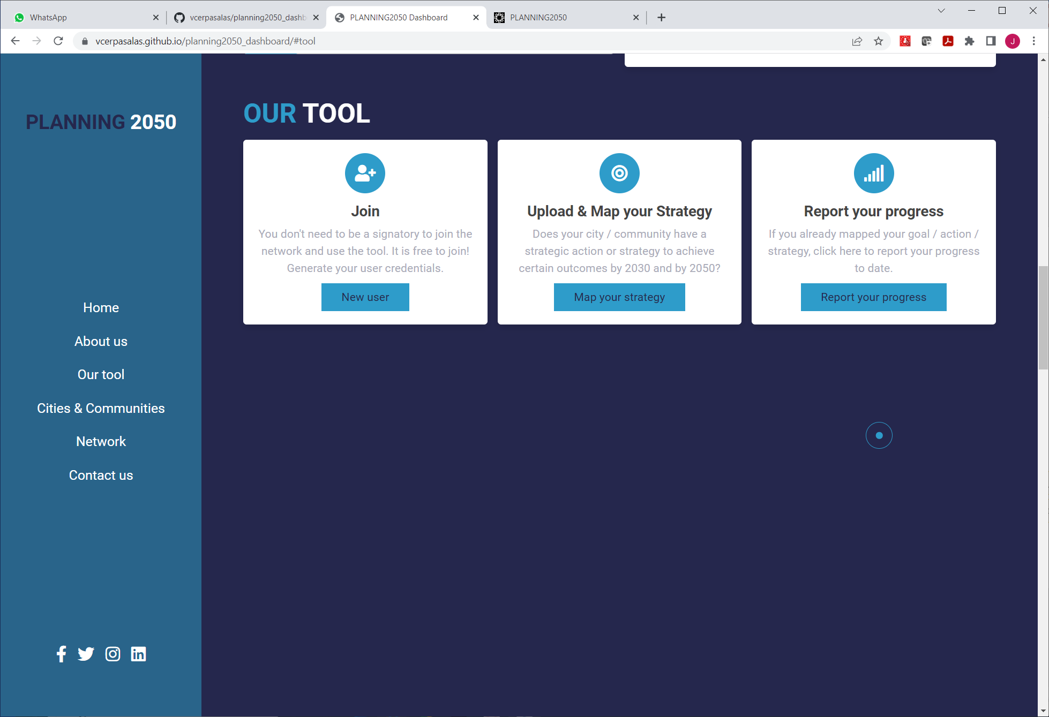
Takes you to “scatter page” once you are already logged in.
Takes you to:
#login page / create new user
Takes you to “profile page” to see “MY STRATEGIES” once you are already logged in.
Add text or something like “Welcome #username” once you have logged in. If not logged in, add button?

Slide 3
THIS IS THE “NEW USER LOGIN PAGE” IDEA
NEW USER:
SIGNATORY
NEW USER:
NON SIGNATORY
Add button to “log in (if already a registered user”
Any of these 2 blocks will make you create a profile (email password, address, city, age, gender)
Add text or something like “Welcome #username” once you have logged in.

Slide 4
For signatories, there will be a list (2min) strategies
THIS IS THE “PROFILE PAGE” IDEA
MY STRATEGIES
There will be 2 types of profiles:
SIGNATORY
NON SIGNATORY
MY PROFILE.
Name, city, email, password, preferences
If empty, it will take you to scatter plot page “Map your strategy(ies)”
For non-signatories, this will read “search for existing strategies”
Add button to “log out”
Option to upload commitment letter or other document(s)
MY NETWORK
REPORT MY PROGRESS
MY FILES
Links to comp plans or other docs related to the signatory strategies
Add text or something like “Welcome #username” once you have logged in.

Slide 5
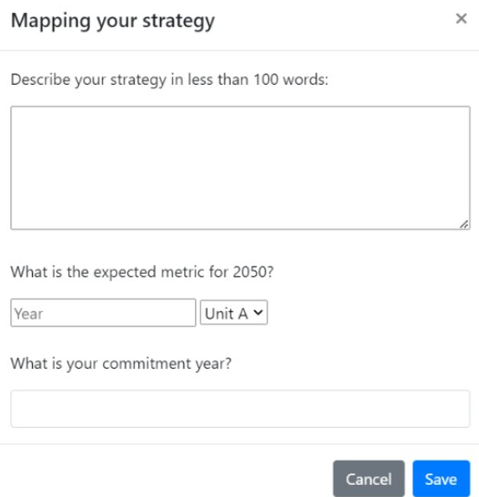
Click on the canvas (cartesian plane) to upload and map your strategy. Click as many points as you would like to register.
SCATTER PLOT PAGE
1
Click
Alert “Name your Strategy” -- OK
Add question “Commitment Year”
When click on dot
Pop-up “Mapping your strategy” -- SAVE
3
Strategy #1
2
Strategy #2
This form “pop-up” will store different data per point. Once clicked “save”, this window disappears
Add button “delete dot”
Clicking on a point opens pop-up for edition of strategy (description, etc)
For each strategy, a new button appears. Max 5 buttons will show
Once mapped, how do we return to this page?
Report progress for “Strategy #1”

Slide 6
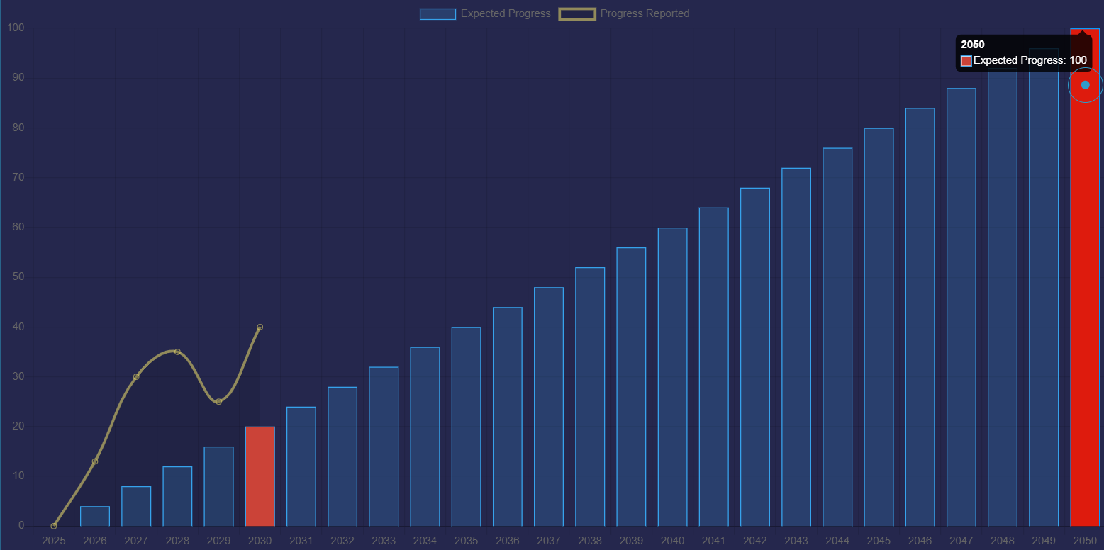
Strategy #1
Strategy #2
THIS IS THE “BAR CHART PAGE” IDEA
Strategy title SHOWS here
Strategy description shows here
Commitment year shows here
BUTTONS show “all strategies one buttons is clear color, and shows active bar chart associated to strategy, other buttons are different color (inactive), changed when click on them
CLV: ok, and good idea to have anyone report on the same strategy.
Add link to contact and/or methodology
Bar chart always start at “commitment year”= 0% (entered when registering dot in scatter plot page).
Text boxes under each year to enter value “float” (percentage value that draws the yellow line). Can’t enter progress in the future, only past and present

Slide 7
UserID
Unique ID, created at new user profile
INITIAL DATABASE IDEA OF VARIABLES (COLUMNS)
Signatory (Y/N)
Could be Boolean value (true/false), or 0 / 1, or Y/N. Created when creating user profile
City / Group Name
From Drop down, or “other” text value. Created when creating user profile
State / Region Name
From Drop down, or “other” text value. Created when creating user profile
Country
From Drop down, or “other” text value. Created when creating user profile
Strategy unique ID
Auto Generated – accessible to all
Strategy coordinates (x,y)
Generated X,Y coordinates in “scatter plot page”
Strategy Name
Generated TITLE or NAME of strategy when drawing a dot in “scatter plot page”
Strategy Description
Generated DESCRIPTION of strategy when clicking on a dot in “scatter plot page”
Strategy Comm. Year
Generated in the pop-up (SCATTER PLOT PAGE) when clicking on a dot in “scatter plot page”
2023 progress
Could be null. If commitment year value is 2023, this will be = 0%. This will be a “float” value
“float” values that generate the yellow curve line
2024 --- 2050 progress
“float” value entered in text boxes (bar chart page)

Slide 8
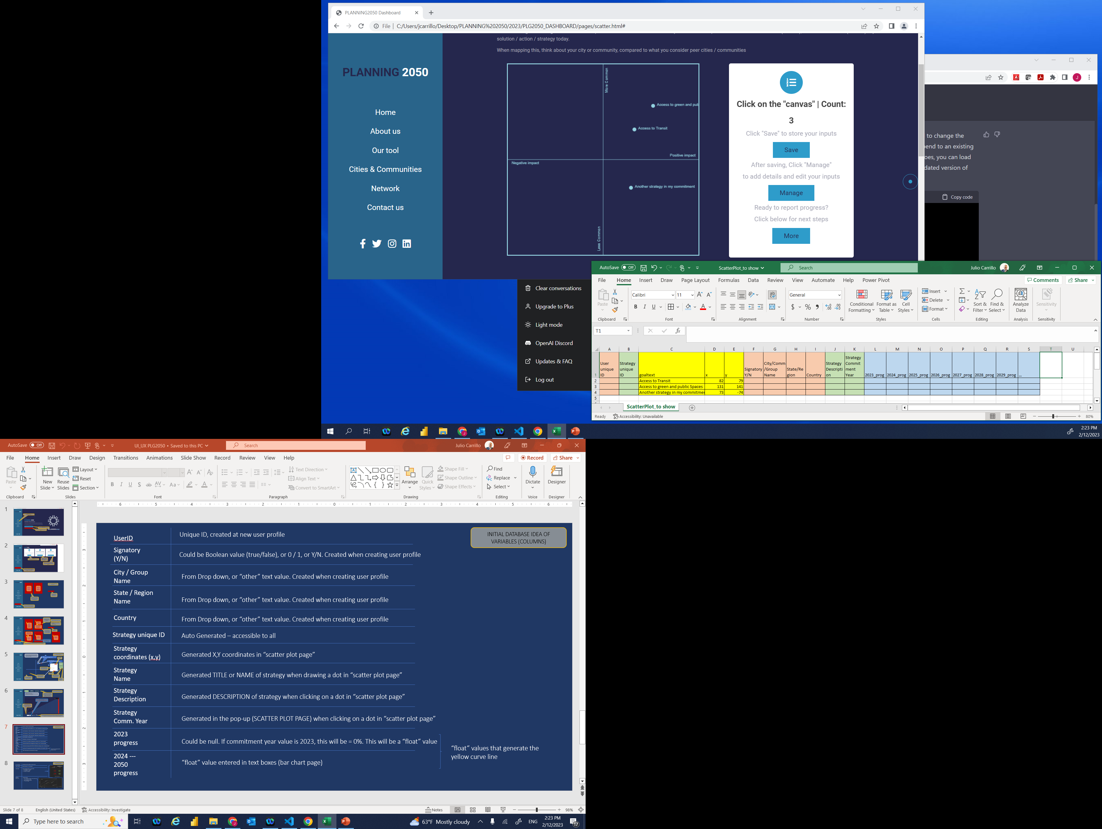
Green section is generated when form or other section is created after “Manage” button
Yellow section is created automatically when clicking on “SAVE” button. This adds coordinates of dots and names of strategies
Blue section is generated with inputs from barchart (text boxes)
This section will be generated when creating a user. If you are not a user, your data is not generated / stored
… more columns / variables (next slide)

Slide 9
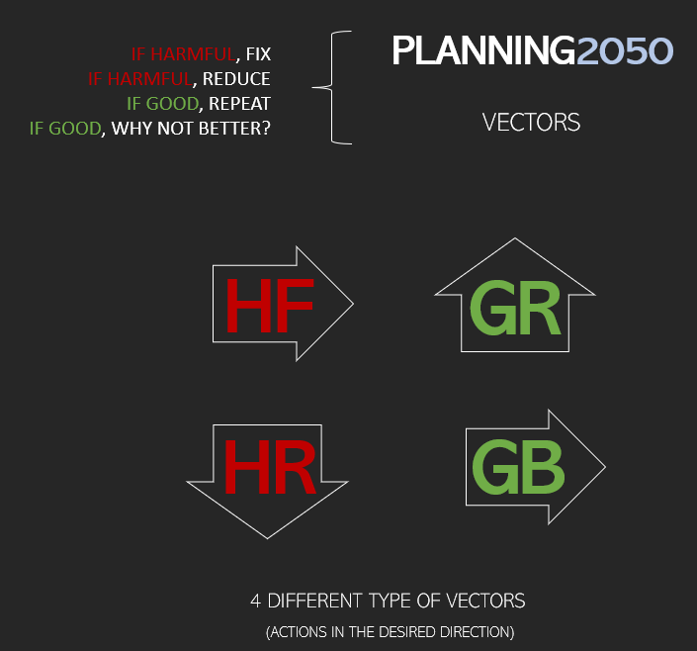
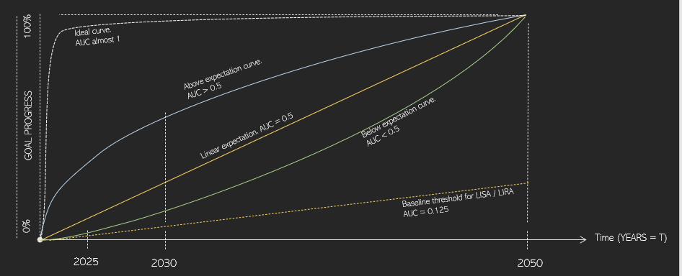
FUTURE DATABASE IDEA OF VARIABLES (COLUMNS)
AUC calculation
Calculate area under yellow curve (bar chart)
Vector “WISH”
Desired location in X,Y coordinates
Vector type
3 types possible, based on X coordinates
If X is negative = “Harmful”
If X is positive = “Good”
If X is zero = “Neutral”
LISA/LIRA impact calc
4 values possible:
“N” = If under 0.125 AUC – not a LISA / LIRA
“S” = 0.125 to 0.5 – small
“M” = 0.5 to 0.6 – medium
“L” = 0.6+ -- large

